Slide 1
2. Menerapkan prinsip keamanan informasi untuk penggunaan jaringan komputer

Slide 2
File Transfer Protocol (FTP) ????
FTP (singkatan dari File Transfer Protocol) adalah sebuah protokol Internet yang berjalan di dalam lapisan aplikasi yang merupakan standar untuk pentransferan berkas (file) komputer antar mesin-mesin dalam sebuah internetwork*.
FTP merupakan salah satu protokol Internet yang paling awal dikembangkan, dan masih digunakan hingga saat ini untuk melakukan pengunduhan (download) dan penggugahan (upload) berkas-berkas komputer antara klien FTP dan server FTP. Sebuah Klien FTP merupakan aplikasi yang dapat mengeluarkan perintah-perintah FTP ke sebuah server FTP, sementara server FTP adalah sebuah Windows Service atau daemon yang berjalan di atas sebuah komputer yang merespons perintah-perintah dari sebuah klien FTP.
Perintah-perintah FTP dapat digunakan untuk mengubah direktori, mengubah modus transfer antara biner dan ASCII, menggugah berkas komputer ke server FTP, serta mengunduh berkas dari server FTP.
*Internetwork adalah sebuah istilah yang merujuk kepada penghubungan dua buah segmen jaringan atau lebih dengan menggunakan sebuah router, sehingga terbuatlah satu buah jaringan yang lebih besar. Paket-paket yang datang dari salah satu jaringan yang tergabung dengan internetwork akan diteruskan ke jaringan tujuannya oleh router, dengan menggunakan proses routing. Teknik ini juga merupakan teknik yang sama yang digunakan untuk menghubungkan antar jaringan di dalam jaringan Internet.

Slide 3
FTP menggunakan protokol Transmission Control Protocol (TCP) untuk komunikasi data antara klien dan server, sehingga di antara kedua komponen tersebut akan dibuatlah sebuah sesi komunikasi sebelum transfer data dimulai. Sebelum membuat koneksi, port TCP nomor 21 di sisi server akan "mendengarkan" percobaan koneksi dari sebuah klien FTP dan kemudian akan digunakan sebagai port pengatur (control port)
FTP hanya menggunakan metode autentikasi standar, yakni menggunakan username dan password. Pengguna terdaftar dapat menggunakan username dan password-nya untuk mengakses, men-download, dan meng-upload berkas-berkas yang ia kehendaki.
Umumnya, para pengguna terdaftar memiliki akses penuh terhadap beberapa direktori, sehingga mereka dapat membuat berkas, membuat direktori, dan bahkan menghapus berkas. Pengguna yang belum terdaftar dapat juga menggunakan metode anonymous login, yakni dengan menggunakan nama pengguna anonymous dan password yang diisi dengan menggunakan alamat e-mail.

Slide 4
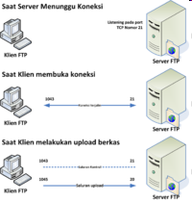
Membuat sebuah koneksi antara klien dan server,
Untuk mengizinkan klien untuk mengirimkan sebuah perintah FTP kepada server dan juga
Mengembalikan respons server ke perintah tersebut

Slide 5
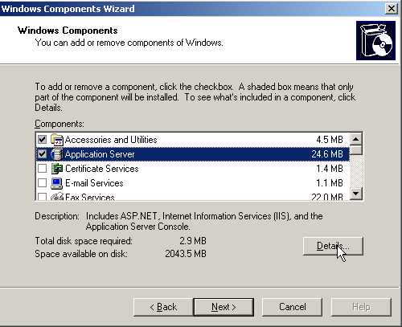
Instalasi FTP Server di Windows 2003 Server
Klik Start >Control Panel > Add or Remove Programs
Pillih Add/Remove Windows Components
Pilih Application Server
Pilih Details

Slide 6
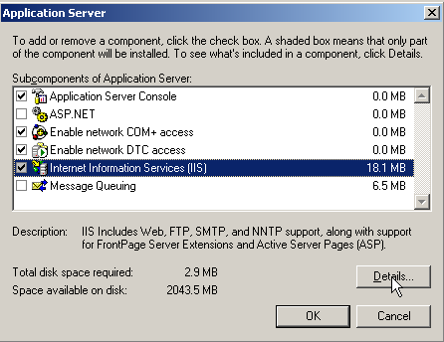
Pilih Internet Information Services (IIS)
Pillih Details

Slide 7
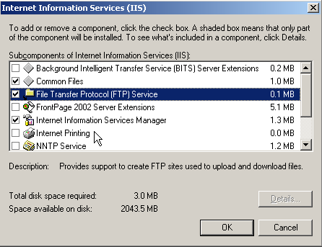
Berikan tanda centang pada cekbox berikut (bila belum terpilih):
→ Common Files
→ File Transfer Protocol (FTP) Service
→ Internet Information Services Manager
Klik Ok, kemudian klik Next

Slide 8
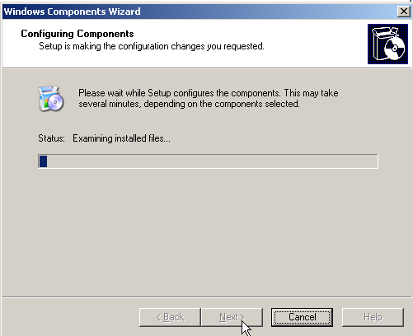
Masukkan CD Win 2003 server bila saat proses instalasi FTP meminta CD master 2003 server

Slide 9
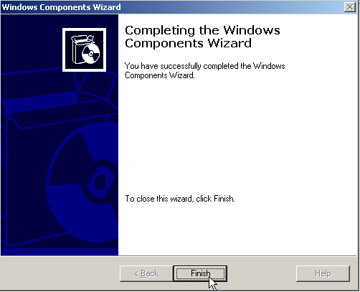
Instalasi FTP selesai, kemudian klik Finish
Setelah layanan FTP service diinstal terlebih dahulu harus dikonfogurasi supaya layanannya dapat digunakan

Slide 10
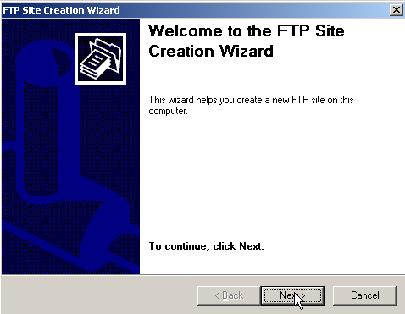
Konfigurasi FTP di Windows 2003 Server
Klik Start >Administrative Tools > Internet Information Services (IIS) manager
Pillih nama server (nama komputer)
Klik kanan pada Ftp Site > New > Ftp Site
Pilih Next

Slide 11
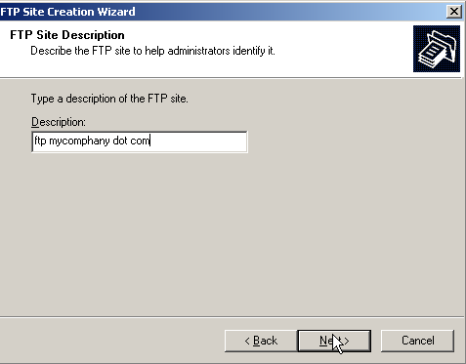
Masukkan deskripsi dari ftp yang akan didefinisikan (misalkan: ftp mycomphany dot com)
Pilih Next

Slide 12
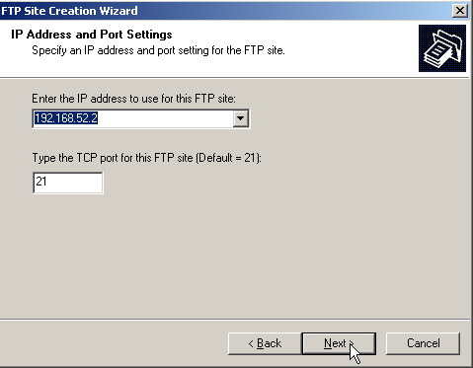
Masukkan IP Address dan port yang akan digunakan
Pilih Next

Slide 13
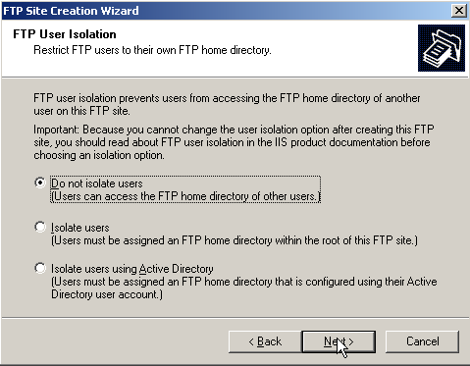
Pilih opsi user yang dapat mengakses ftp (misalkan: Do not isolate users)
Pilih Next

Slide 14
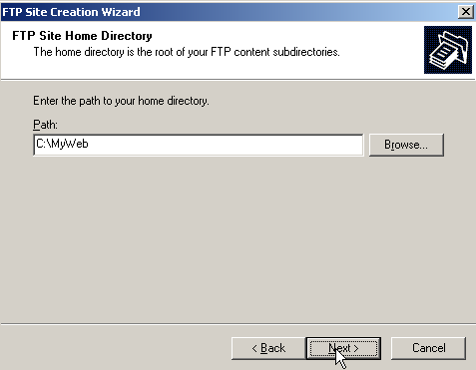
Pilih path yang digunakan untuk home directory ftp (misalkan c:\MyWeb)
Pilih Next

Slide 15
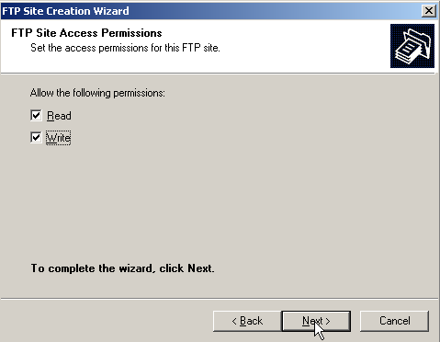
Pilih Permission terhadap ftp yang akan didefinisikan (misal: Read dan Write)
Pilih Next

Slide 16
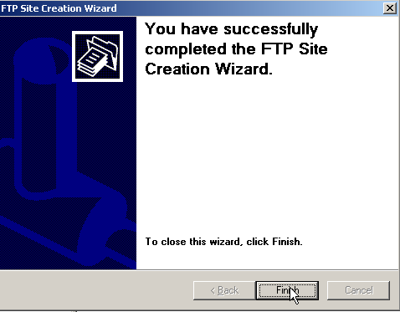
Pendefinisian ftp selesai
Pilih Finish

Slide 17
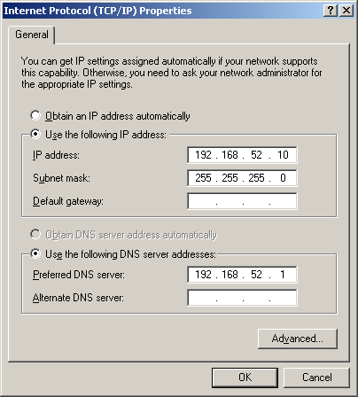
Test di Komputer Client
Pastikan IP Client satu jaringan dengan server
Pada Preferred DNS Server masukkan IP Server (misal: 192.168.52.10)
Klik Ok

Slide 18
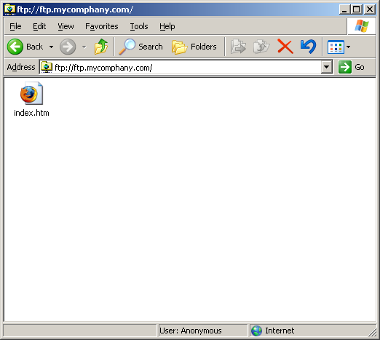
Ketikkan ftp://ftp.mycomphany.com pada windows explorer
Alamat ftp server
username
Setelah tampil seperti tampilan diatas manipulasi file dan folder pun dapat dilakukan
*Alamat ftp.mycomphany.com sebelumnya didefinisikan terlebih dahulu di DNS server

Slide 19
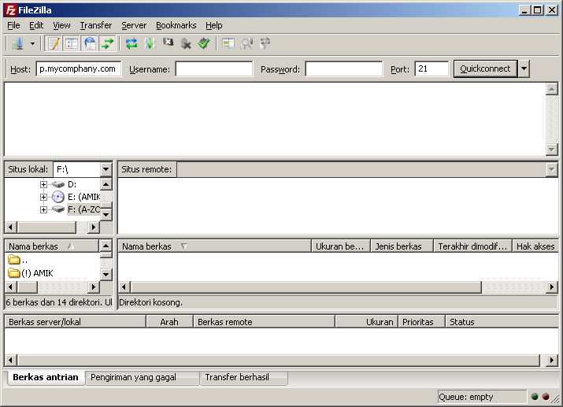
Test Menggunakan Program FTP Client
Installkan terlebih dahulu program ftp client FileZilla di komputer client
Kemudian buka FileZilla
Isi Host, Username, Password dan Port yang digunakan
Pilih Quickconnect

Slide 20
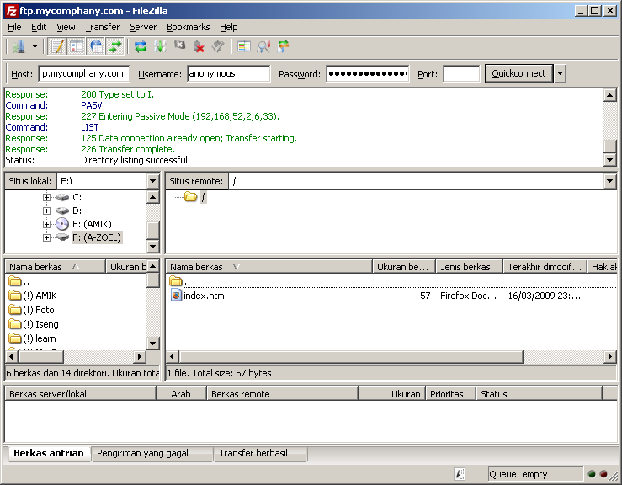
Selanjutnya dapat dilakukan manipulasi folder atau file yang diinginkan
File/folder komputer lokal (client)
File/folder komputer server

Slide 21
What is a Firewall?
Either software or hardware based
Keeps networks secure
Works based on predetermined rules
Port security
Stateful packet inspection
Records all connections and determines connection state
Connections must be initiated by source/client and not receivers.
Notes:
21

Slide 22
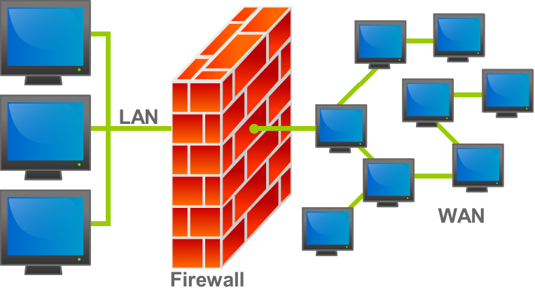
What is a Firewall?
Notes:
22

Slide 23
Firewall Installation
root@yourdomain:~# wget http://www.configserver.com/free/csf.tgz
root@yourdomain:~# tar -xzf csf.tgz
Tar –xzf is the command to uncompress an archived file
x = extract z = filter the archive through gzip f=archive file name
root@yourdomain:~# cd csf
root@yourdomain:~/csf# sh install.sh
Sh install.sh is a script that configures csf firewall for the OS the VPS is running.
Notes:
23

Slide 24
Firewall Installation
OOPS! can’t find perl module. Google the error!
Google “can't locate lwp/useragent.pm in @inc (@inc contains”
It appears other people have had the same issue!
Advantage of Linux is since its open source someone is bound to have the same problem. Google has the answers.
Notes:
24

Slide 25
Firewall Installation
root@yourdomain:~/csf# apt-get install libwww-perl
root@yourdomain:~/csf# sh install.sh
Next, test whether you have the required iptables modules:
root@yourdomain:~/csf# perl /etc/csf/csftest.pl
RESULT: csf should function on this server
root@yourdomain:~/csf# cd ..
root@yourdomain:~# cd ..
root@yourdomain:/# cd etc
root@yourdomain:/etc/csf# vi csf.conf
Notes:
25

Slide 26
Firewall Installation
Csf.conf
Edit conf file by reading instructions.
Change from testing mode to live mode.
Add 3128 proxy port to TCP IN/OUT.
Save changes
Restart csf
root@yourdomain:/etc/csf# csf –r
root@yourdomain:/etc/csf# lfd –r
Lfd (login Failure Daemon) logging software that logs failed loggings and brute force attacks.
Notes:
26

Slide 27
Firewall Installation
Check mail to see if you have any hacker attacks!
root@yourdomain:/etc/csf# mail
N 2 root@yourdomain.c Sun Mar 17 02:01 23/926 lfd on yourdomain: Excessive resource usage: proxy (3204 (Parent PID:3201))
Oops! this MSG will fill up mailbox real quick. Message means that logging server is flagging what it thinks is suspicious activity due to VPS memory limitations. We will disable this alert.
Go back and edit csf.conf
Scroll down and set PT_USERPROC, PT_USERMEM, and PT_USERTIME = “0”
Restart csf and lfd.
Notes:
27

Slide 28
Firewall Installation
No hacker attempts so lets create one.
Have person next to you, SSH to your VPS but enter wrong password.
Log into your VPS.
Login to mail.
Investigate the mail msg.
Notes:
28

Slide 29
Firewall Completion
Congratulations Linux Guru. You have successfully completed this training module.
Notes:
29

Slide 30
What is a Virtual Private Network?
A VPN is a virtual point to point connection between a client and receiver through the use of dedicated connections and encryption.
Protects the confidentiality of information.
Common uses
Private and secure connection between your home computer and your online banking website. This is known as Secure Socket Layer (SSL)
Government uses for the protection of classified information in transmit.
Corporations use it to communicate between regional offices.
Notes:
30

Slide 31
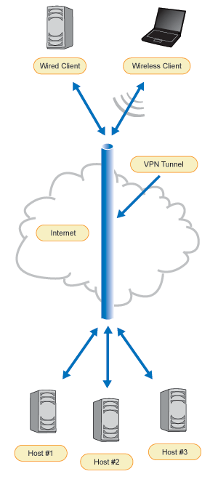
What is a Virtual Private Network?
Notes:
31

Slide 32
VPN Installation
What is OpenVPN?
OpenVPN is an open source software application that implements a VPN.
Uses a custom security protocol that uses SSL/TLS for key exchange.
OpenVPN allows peers to authenticate to each other using pre-shared (secret key) and certificates.
Secret key is called “symmetric encryption.”
Asymmetric is used to encrypt (protect) the secret key during key exchange.
Symmetric is used to encrypt and decrypt information once key exchange has been established.
Notes:
32

Slide 33
VPN Installation
What root@yourdomain:~# apt-get install openvpn
Copy easy-rsa into the correct place
cp -R /usr/share/doc/openvpn/examples/easy-rsa /etc/openvpn
Easy-rsa is the folder that will hold the certifications and secret keys.
Cp –R = command for copying directories recursively (will copy all files and directories)
Notes:
33

Slide 34
VPN Installation
Generate Keys
cd /etc/openvpn/easy-rsa/2.0
./vars (./=execute file in current directory)
Permission denied
chmod +x vars
./clean-all
source the vars script first (i.e. "source ./vars")
source ./vars ./clean-all
./build-ca
./build-key-server server
./build-key client
./build-dh (Use DIFFIE-HELLMAN encryption algorithm)
Notes:
34

Slide 35
VPN Installation
Apply iptables rules
iptables are the tables provided by the Linux kernel firewall
Linux comes with a built in kernel firewall called iptables. We use CSF as a wrapper which provides management of the iptables for us. However, in order for OpenVPN to work we must enter specific iptable commands.
Forward the IP
Vi /etc/sysctl.conf
Configuration file for setting system variables
#net.ipv4.ip_forward=1
Remove the #. This will enable packet forwarding for IPv4 for OpenVPN to work.
Notes:
35

Slide 36
VPN Installation
Run the forward
root@yourdomain:/etc/csf# Sysctl –p
Should see the following result:
Net.ipv4.ip_forward=1
Create iptables rules
Iptables –t nat –A POSTROUTING –s 10.8.0.0/24 –o venet0 –j MASQUERADE
-t specifies the packet matching table which command should use
Nat – packet matching table that defines how packet should be routed.
-A specifies one or more chain rules.
POSTROUTING – altering a packet as it goes out
-s source address and subnet mask
-o out interface
venet0– interface packet will use to go out.
-j jump target Specifies target of the rule i.e., what to do if the packet matches it.
MASQUERADE translates the private IP address to public.
Notes:
36

Slide 37
VPN Installation
ETHERNET2 +------------+ +-------------+
to ISP provider | Linux #1 | ETHERNET1 | Anybox |
| | | |
<--------- venet0 | IP Tables |venet0 -------- NIC CARD | Virtual |
| MASQ. | | Tun/TAP |
198.147.X.X | | 10.8.X.X | Card |
+------------+ +-------------+
In the above drawing, a Linux box with IP_MASQUERADING is installed as Linux #1 and is connected to the Internet via Ethernet2 It has an assigned public IP address of 198.147.X.X. It also has another network interface (venet0) connected to allow incoming network traffic be it from a ETHERNET1 connection.
Notes:
37

Slide 38
VPN Installation
ETHERNET2 +------------+ +-------------+
to ISP provider | Linux #1 | ETHERNET1 | Anybox |
| | | |
<--------- venet0 | IP Tables |venet0 -------- NIC CARD | Virtual |
| MASQ. | | Tun/TAP |
198.147.X.X | | 10.8.X.X | Card |
+------------+ +-------------+
The second system (which does not need to be Linux) connects into the Linux #1 box and starts its network traffic to the Internet. This second machine does NOT have a publicly assigned IP address from the Internet, so it uses say 10.8.X.X
Notes:
38

Slide 39
VPN Installation
ETHERNET2 +------------+ +-------------+
to ISP provider | Linux #1 | ETHERNET1 | Anybox |
| | | |
<--------- venet0 | IP Tables |venet0 -------- NIC CARD | Virtual |
| MASQ. | | Tun/TAP |
198.147.X.X | | 10.8.X.X | Card |
+------------+ +-------------+
With IP Masquerade and the routing configured properly, this second machine "Anybox" can interact with the Internet as if it was directly connected to the Internet with a few small exceptions [noted later].
Notes:
39

Slide 40
VPN Installation
ETHERNET2 +------------+ +-------------+
to ISP provider | Linux #1 | ETHERNET1 | Anybox |
| | | |
<--------- venet0 | IP Tables |venet0 -------- NIC CARD | Virtual |
| MASQ. | | Tun/TAP |
198.147.X.X | | 10.8.X.X | Card |
+------------+ +-------------+
I tell machine ANYBOX that Linux box is its gateway.
When a packet comes into the Linux box from ANYBOX, it will assign the packet to a new TCP/IP source port number and insert its own IP address inside the packet header, saving the originals. The MASQ server will then send the modified packet over the ETHERNET interface onto the Internet.
Notes:
40

Slide 41
VPN Installation
ETHERNET2 +------------+ +-------------+
to ISP provider | Linux #1 | ETHERNET1 | Anybox |
| | | |
<--------- venet0 | IP Tables |venet0 -------- NIC CARD | Virtual |
| MASQ. | | Tun/TAP |
198.147.X.X | | 10.8.X.X | Card |
+------------+ +-------------+
When a packet returns from the Internet into the Linux box, Linux examines if the port number is one of those ports that was assigned above. If so, the MASQ server will then take the original port and IP address, put them back in the returned packet header, and send the packet to ANYBOX.
The host that sent the packet will never know the difference.
Notes:
41

Slide 42
VPN Installation
Create the VPS OpenVPN configuration file
root@yourdomain:/etc/openvpn# wget http://www.dorkatron.com/docs/POS420/server.conf
vi /etc/openvpn/server.conf
port 1194
proto tcp
dev tun
ca /etc/openvpn/easy-rsa/2.0/keys/ca.crt
cert /etc/openvpn/easy-rsa/2.0/keys/server.crt
key /etc/openvpn/easy-rsa/2.0/keys/server.key
dh /etc/openvpn/easy-rsa/2.0/keys/dh1024.pem
server 10.8.0.0 255.255.255.0
ifconfig-pool-persist ipp.txt
push "redirect-gateway def1"
push "dhcp-option DNS 10.8.0.1"
client-to-client
duplicate-cn
keepalive 10 120
comp-lzo
user nobody
group nogroup
persist-key
persist-tun
status openvpn-status.log
log /var/log/openvpn.log
verb 3
Notes:
42

Slide 43
VPN Installation
Start OpenVPN
root@yourdomain:/etc/openvpn# openvpn server.conf
starts openvpn using server.conf file
Create the PC OpenVPN Configuration file
cd /etc/openvpn/easy-rsa/2.0/keys/
wget http://www.dorkatron.com/docs/POS420/client.conf
Notes:
43

Slide 44
VPN Installation
Config.conf
client dev tun proto tcp remote 198.147.XX.XXX 1194 resolv-retry infinite nobind persist-key persist-tun ca ca.crt cert client.crt key client.key comp-lzo verb 3 redirect-gateway script-security 2
Notes:
44

Slide 45
VPN Installation
Reboot
vi /etc/rc.local
Write the following contents above “exit o”
iptables -t nat -A POSTROUTING -s 10.8.0.0/24 -o venet0 -j MASQUERADE
Notes:
45

Slide 46
VPN Installation
Download Certs and Keys
Caution! Use secure means! Keys and certs are not encrypted. SFTP or SSH.
client.conf
ca.crt
client.crt
client.key
Reboot VPS
Install Wireshark
Install OpenVPN client on desktop
Move Certs and Keys into OpenVPN config folder
Notes:
46

Slide 47
VPN Installation
Configure the client.ovpn file
Notes:
47

Slide 48
VPN Completion
Congratulations Linux Guru. You have successfully completed this training module.
Notes:
48

Slide 49
Agenda
What and why?
PGP
Keys and key pairs
Encrypting messages
Signing messages
Verifying keys – key signing
Installation on windows XP and exercise

Slide 50
What and Why?
E-mail is not secure
as easy to fake E-mail as a typed letter.
Anyone can read it on the network.
How to know you are who you say you are?
Ways to secure E-mail
Digital signatures
Encryption
Secure transactions

Slide 51
PGP – Pretty Good Privacy
1976 – Diffie/Hellman.
1977 – Rivest/Shamir/Adleman.
1991 – Zimmermann writes PGP.
Send E-mail securely to a known recipient.
Digitally sign E-mail so that the recipient(s) can be sure it is from you.
Can also be used with file transfers.
Similar is used for secure web pages.

Slide 52
Keys and Key Pairs
Encryption is a way of changing something to something else.
e.g. simple 3-letter shift.
tony brett becomes wrqb euhww.
But the recipient has to know the “key”.
How do you tell them securely?
Asymmetric keys are the answer!
Public/Private keys.
“Fingerprint” for verification
Pass phrase on private for security
Include E-mail address(es)

Slide 53
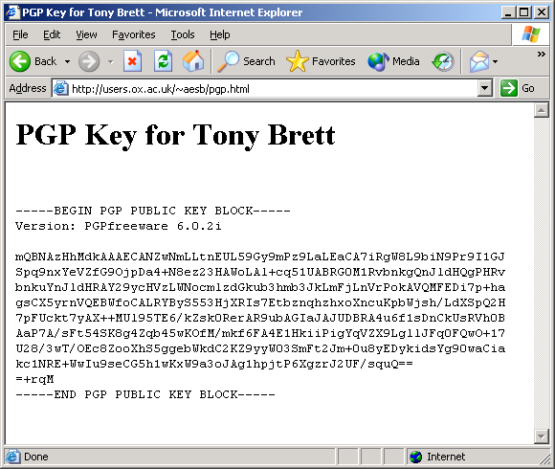
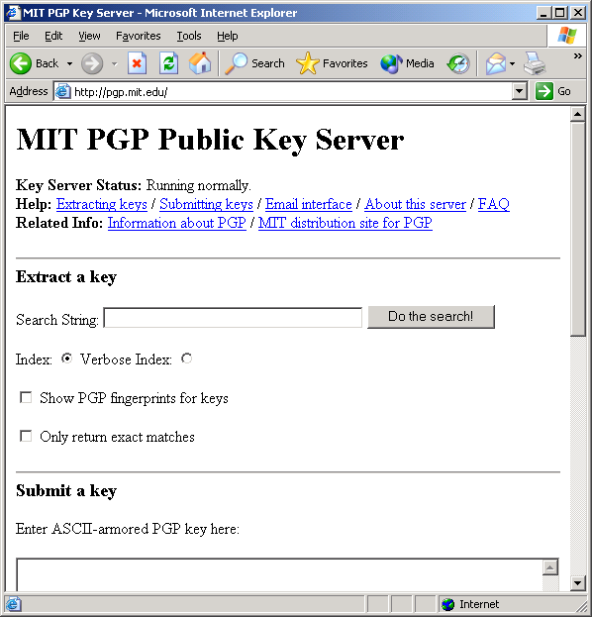
Where do I find someone’s key? (and publicise mine)
Key Servers or Personal Web Pages

Slide 54
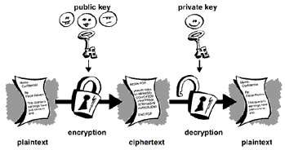
Encrypting Messages
Use recipient's public key.
Then only they can decrypt it.
Can encrypt to several if more than one recipient.
Then any one private key can decrypt message.
No guarantee it is from you, but only they can read it.

Slide 55
Signing Messages
Use your own private key.
So long as recipient is sure they have your key they can be sure the message came from you.
Your public key is widely available

Slide 56
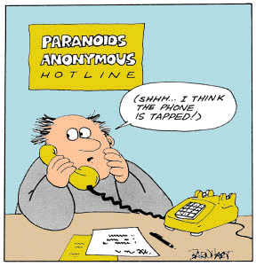
For the Paranoid….
Encrypt the message with recipient’s public key and sign with your own private key.
Then it’s verifiably from you and you can be sure only they can read it!

Slide 57
How do you know this key is mine?
Anyone could generate a key for anyone else.
Signing a key confirms that it belongs to the right person.
Verify identity by voice, passport, driving licence etc.
Use fingerprint to make sure you have the right one.
Creates chain of trust.
Key signing events do happen
http://www.ox.compsoc.net/compsoc/events/pgp-keysigning.html

Slide 58

How to Install PGP on Windows
Download from: http://www.pgp.com/products/freeware.html
Note License Restrictions
Extract PGP8.EXE from ZIP file

Slide 59
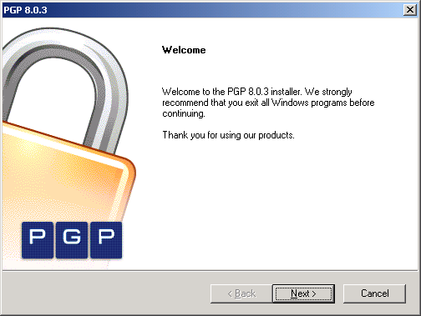
Installation

Slide 60
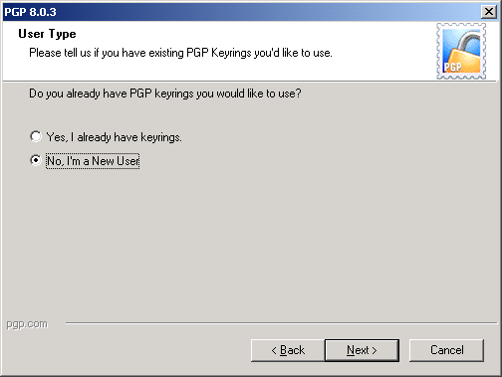
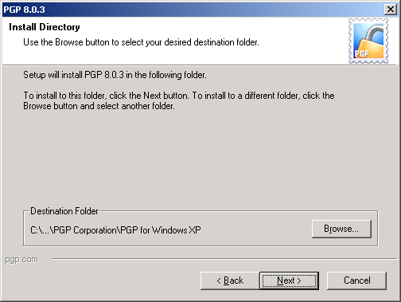
Installation
Choose to create keys and set install directory – defaults are fine!

Slide 61
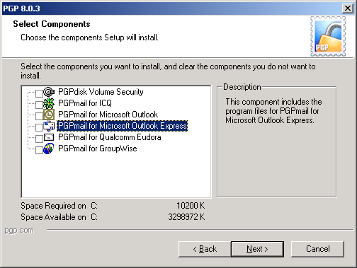
Select Components

Slide 62
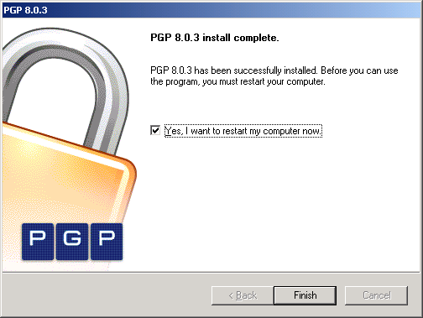
Finish install and restart computer

Slide 63
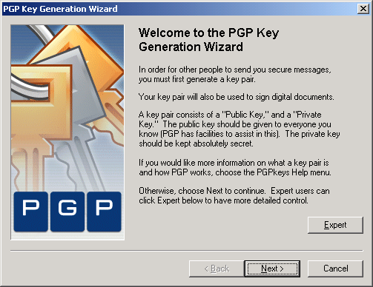
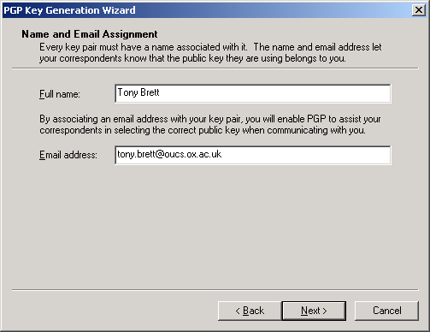
Creating your key pair
Run PGP Keys.
Choose “New Key” from “Keys”.
You’ll need name and E-mail.

Slide 64
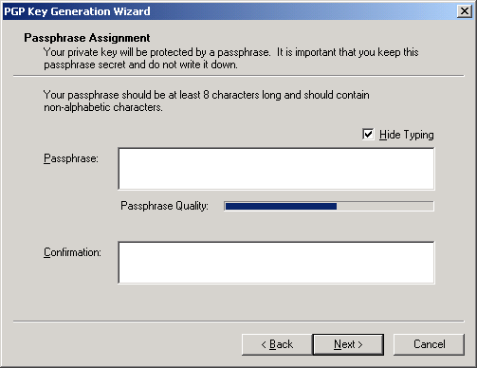
The Passphrase is VITAL!
It’s your only protection from others using your private key!

Slide 65
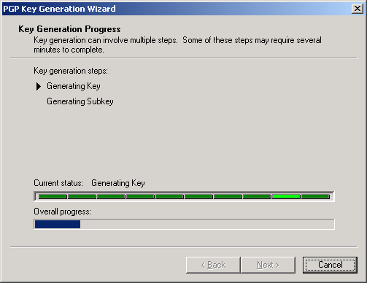
Key gets generated

Slide 66
Exercises
Send public key to a server.
Try using the clipboard encryption facility
Keep your private key safe and passphrase protected.
You can’t revoke a key without the private key.
Get public key for tony.brett@oucs.ox.ac.uk and try to send me an encrypted message
Get your public key signed.

Slide 67
Resources
http://www.oucs.ox.ac.uk/email/secure.html
http://www.pgpi.org/
http://www.pgpi.org/doc/faq/
http://users.ox.ac.uk/~aesb/pgp.ppt

